Slide 1
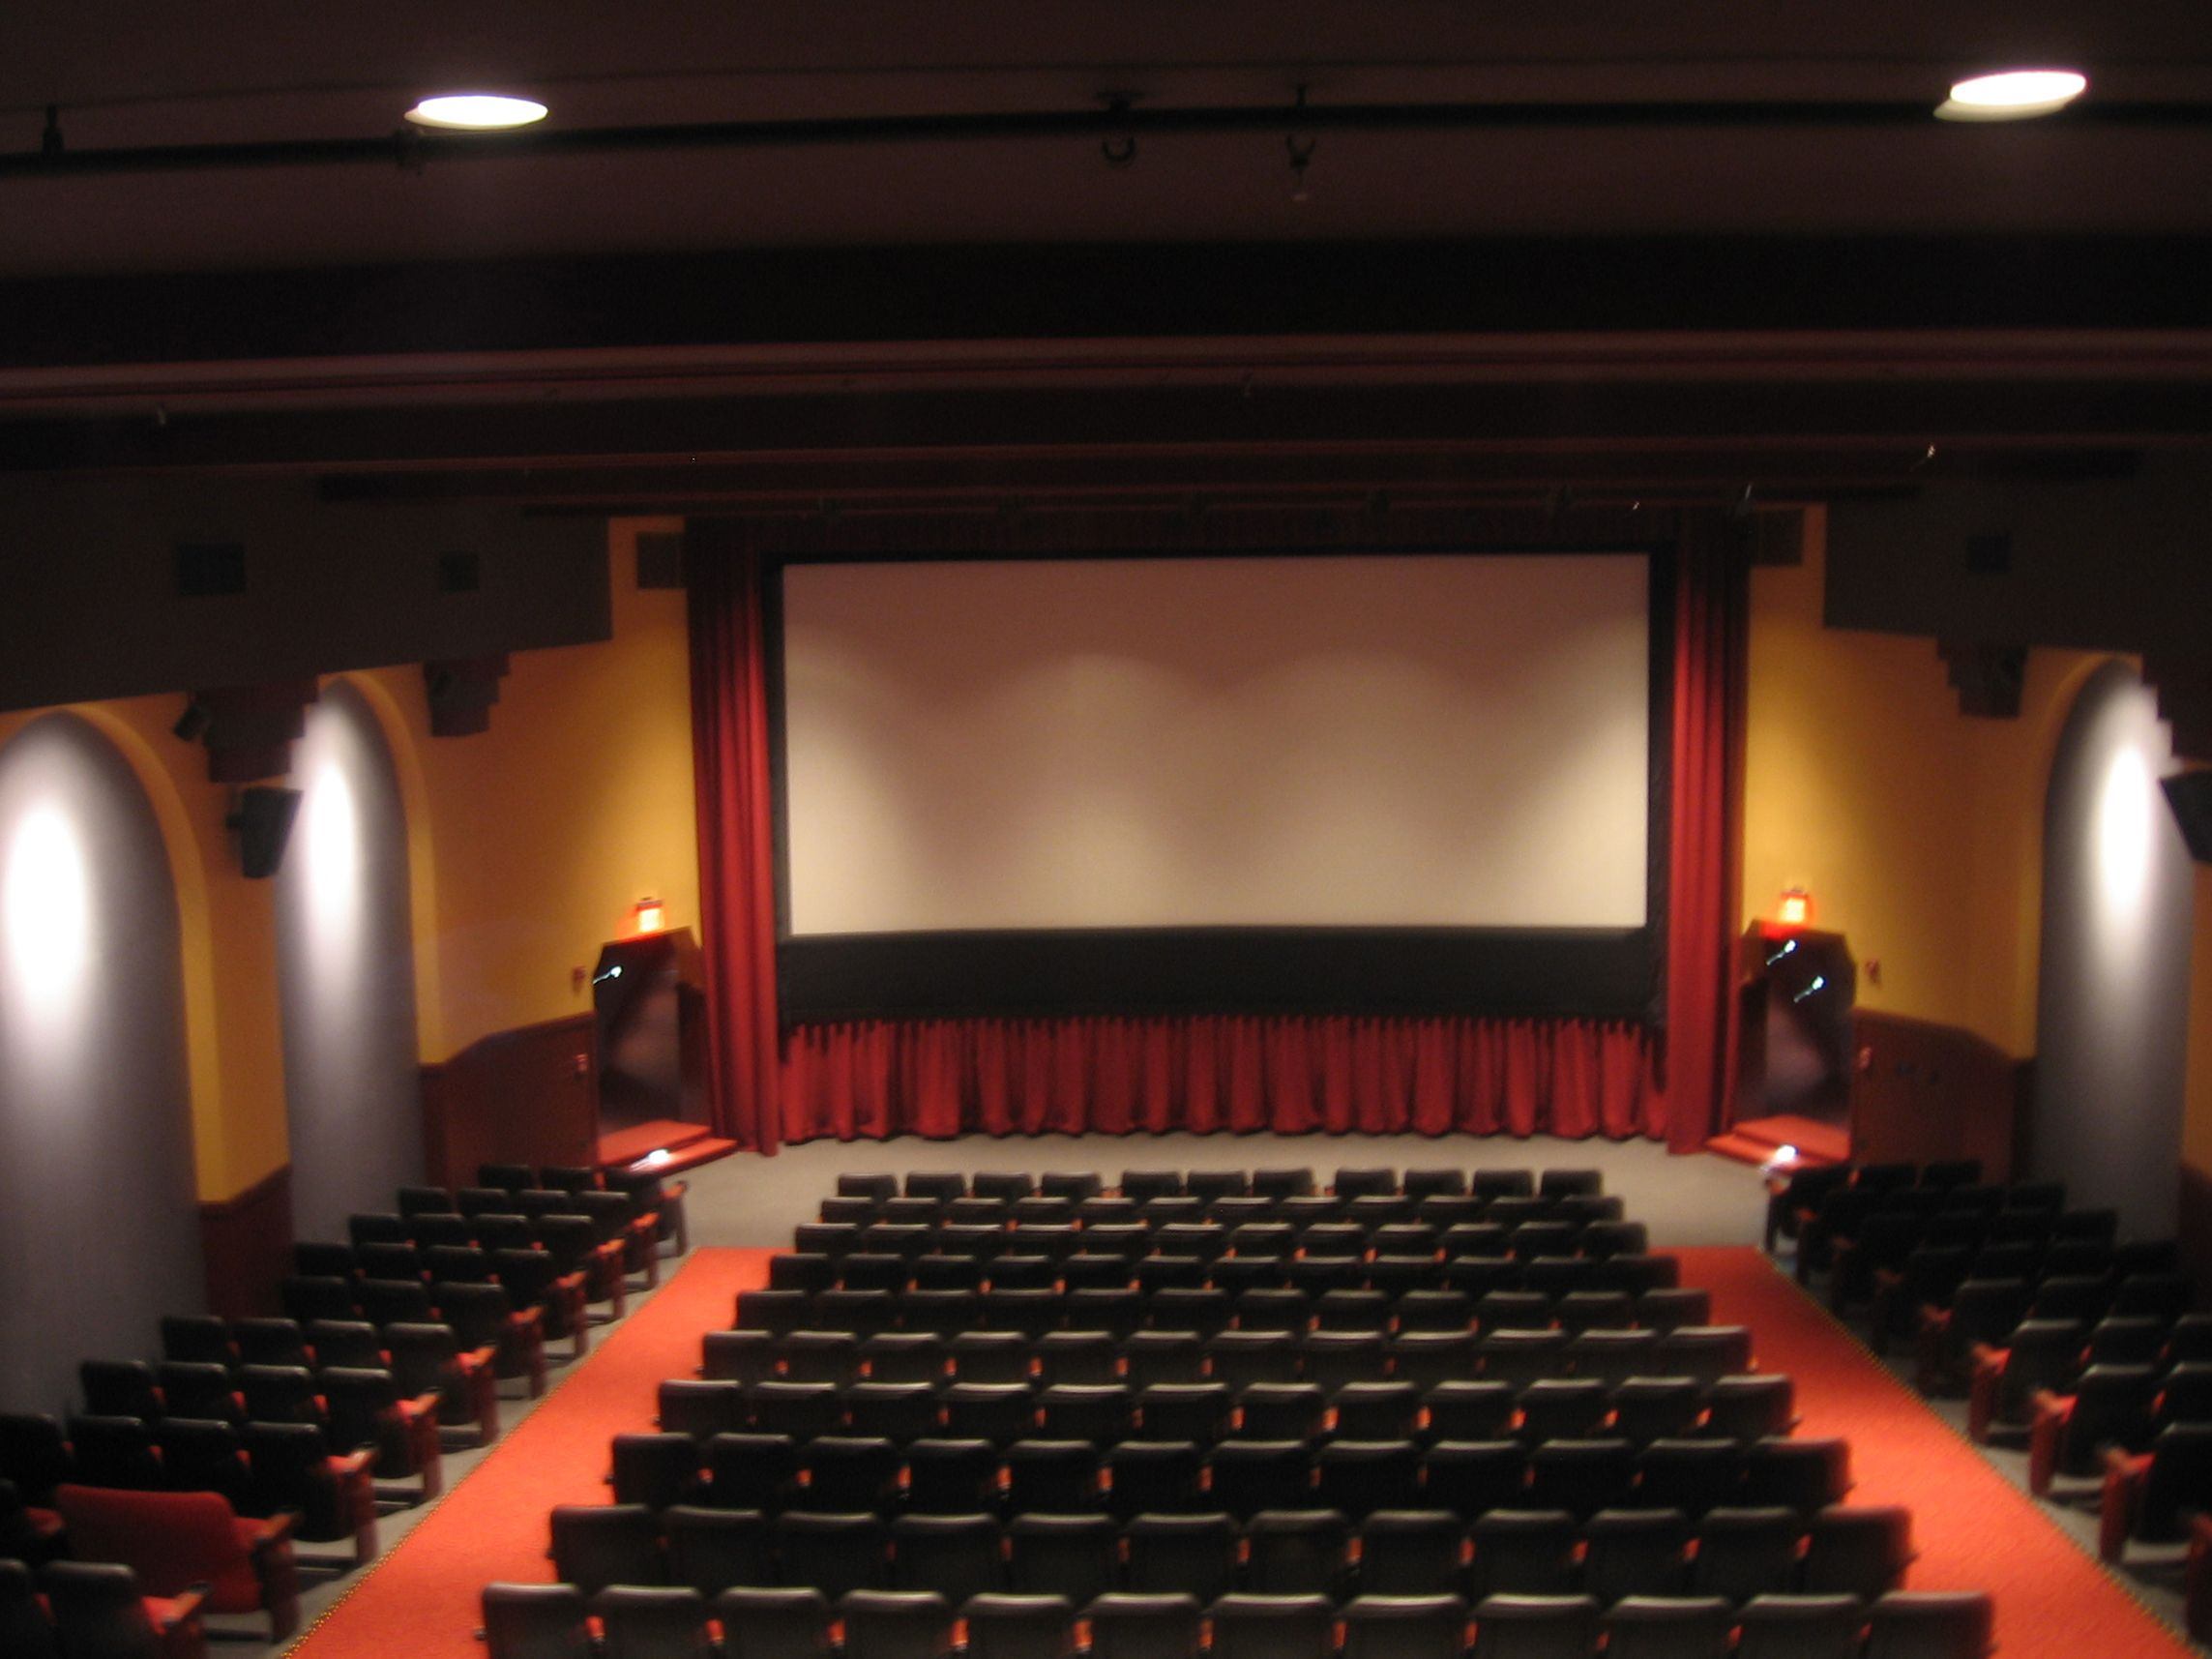
Entertainment and Leisure Movie Theatre Database
By:
Luis
Yunzhe Yu
Joseph Lord
Pedro Lorenzano Rodriguez

Slide 2
Overview
Thousands of customers patronize three local movie theatre branches every year. These theatres are known for their quality of service and their outstanding customer support.
All three local theatres have been purchased by the same owner and merged into a single company, called “CC Cinema”, and they need a database to increase the efficiency, allow for scalability, and cut down the wasted time so as to provide a better experience for their customers.

Slide 3


Introduction
Our database is designed to provide the backbone for all day-to-day operations at a movie theatre.
Anything from buying candy to filling out surveys to keeping track of equipment.

Slide 4
Entities
Staff
Branches
Concessions
Tickets
Customers
Inventory
Memberships
Surveys
Special Screenings
Shows
Movie Catalog
Promotions

Slide 5
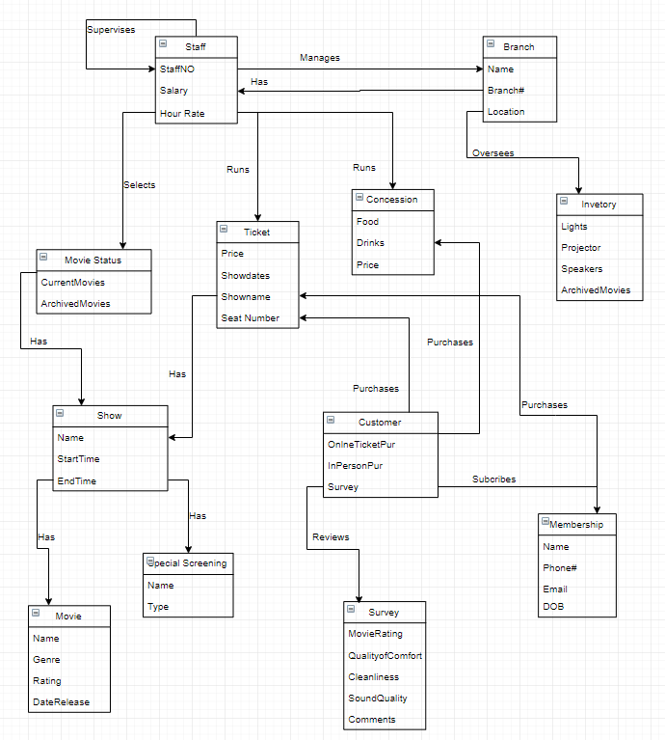
Entity Relationship Diagram

Slide 6
Create Statements
CREATE TABLE staff ( staff_id number(4) primary key, fname varchar2(128) not null, lname varchar2(128) not null, position varchar2(255), salary number(6), hours_worked number(3), branch_id number(2) not null, CONSTRAINT salary_ck check(salary >= 15000), CONSTRAINT position_ck check(position='Manager'
or position='Maintenance' or position='Shift Lead'
or position='Part-Time' or position='Marketing Rep'
or position='Cashier')
);
CREATE TABLE inventory ( equip_tag number(6) primary key, equip_name varchar2(255), model varchar2(255) not null, manufacturer varchar(1024), serial varchar2(255) not null, location varchar2(255) not null, purchase_date DATE not null, cost number(10), last_maintenanced DATE );

Slide 7
Before Alter: FOREIGN KEY
Branch_ID (Entity: Staff, Concession, Survey, Special Screening, Show)
Membership_ID (Entity: Customer)
Concession_name
Movie_ID (Entity: Tickets, Survey)

Slide 8
Alter Statements
ALTER TABLE staff
ADD Constraint staff_branch_id_FK FOREIGN KEY(branch_id)
REFERENCE branches (branch_id);
ALTER TABLE concession
ADD Constraint concession_branch_id_FK FOREIGN KEY(branch_id)
REFERENCE branch (branch_id);
ALTER TABLE concession
ADD Constraint concession_branch_id_FK FOREIGN KEY(branch_id)
REFERENCE branch (branch_id);

Slide 9
Insert Statements
INSERT INTO staff VALUES (0104,'Jim','Lahey','Manager',50000,120,01), (0118,'Randy','Burder','Shift Lead',31200,103,01), (0221,'Ricky','Dubbs','Maintenance',33400,212,03), (0127,'James','Rock','Marketing Rep',48700,110,02); INSERT INTO branches VALUES (01,'CC Cinema 1','152 Scout Ln'), (02,'CC Cinema 2','215 Balig St'), (03,CC Cinema 3','1515 Prospect St');
INSERT INTO surveys VALUES (78953387,58090834,3,5,7,4,'Sucks',03), (68589408,77698211,9,9,8,7,'Pretty good',01), (88712211,32333212,9,10,5,10,'Cool',01), (50000321,48372984,8,7,8,9,'Movie was meh',02);

Slide 10
Index Statements
Advantage:
1. Don’t need to scan all database when you want to find a specific data.
2. By using index, the retrieval speed of database can be greatly improved and the performance of database can be improved.

Slide 11
Index Statements
CREATE INDEX staff_LastName_Index ON staff (lname)
CREATE INDEX membership_fname_Index ON memberships (fname)
CREATE INDEX datetime_Index ON tickets (DATETIME)
Etc.

Slide 12
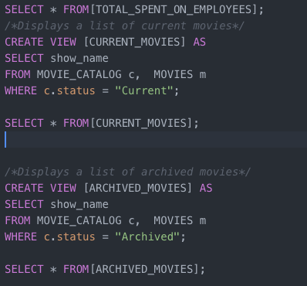

VIEWS

Slide 13
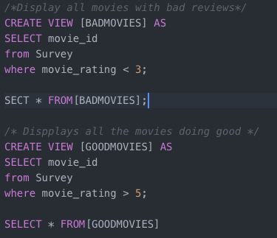

More Views

Slide 14


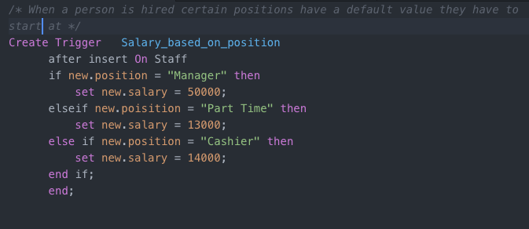
Triggers

